Slide 1
Women Security

Slide 2
LIST OF CONTENTS
Hardware and Software components
Advantages
Applications
Result
Introduction
Literature Review
Objective
Existing System
Proposed System
Block diagram
Working

Slide 3
INTRODUCTION
The world is becoming unsafe for women in all aspects,why because crimerate of the women is increasing day by day.
So every one try to protect women safety and the governement should also try to provide different acts in our socitey.

Slide 4
LITERATURE REVIEW
S.NO | AIM | FINDING | MISSING GAPS | REFERENCES
1 | Smart electronic system for women safety | Embedded board GPS,GSM and key board matrix | Applicable only for vehicles Self carrying is not possible | S.Shambhavi et al. (2016)
2 | Women protection system using 8051 micro controller | 8051 Microcontroller, GSM,GPS | It sends only co-ordinates of the location. | P.Priyanka et al. (2018)

Slide 5
OBJECTIVE
The main objective of this project is an (attempt) to provide safety and security for womens.

Slide 6
EXISTING SYSTEM
POWER
SUPPLY
8051 MICRO CONTROLLER
GSM
PUSH BUTTON SWITCH
GPS

Slide 7
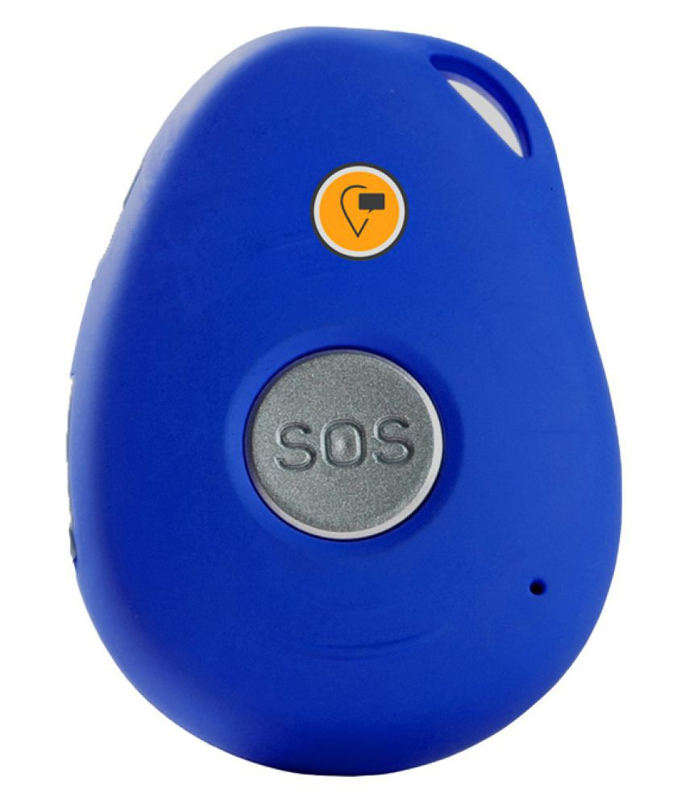
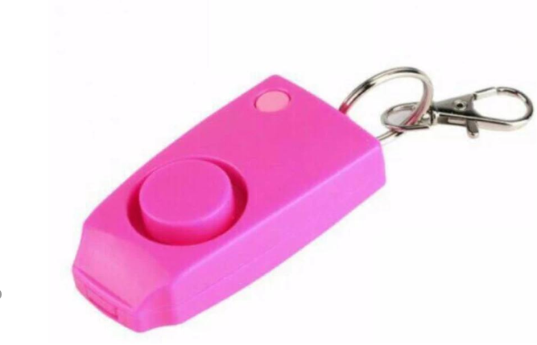
DISADVANTAGES OF EXISITING SYSTEM
It does not have own Integrated Development Environment (IDE)
Memory capability is less
Operates in less voltage
Instruction set is complex
Smart location tracker

Slide 8
PROPOSED SYSTEM
The design of proposed system is based on embedded real time system
It sends alert messages automatically
This system provides electric shock

Slide 9
BLOCK DIAGRAM
POWER
SUPPLY
ARDUINO
(Nano)
GSM
ALCOHOL
SENSOR
GPS
SOUND
SENSOR
BUZZER
PULSE RATE
SENSOR
SHOCK DEVICE
PANIC
SWITCH
LCD

Slide 10
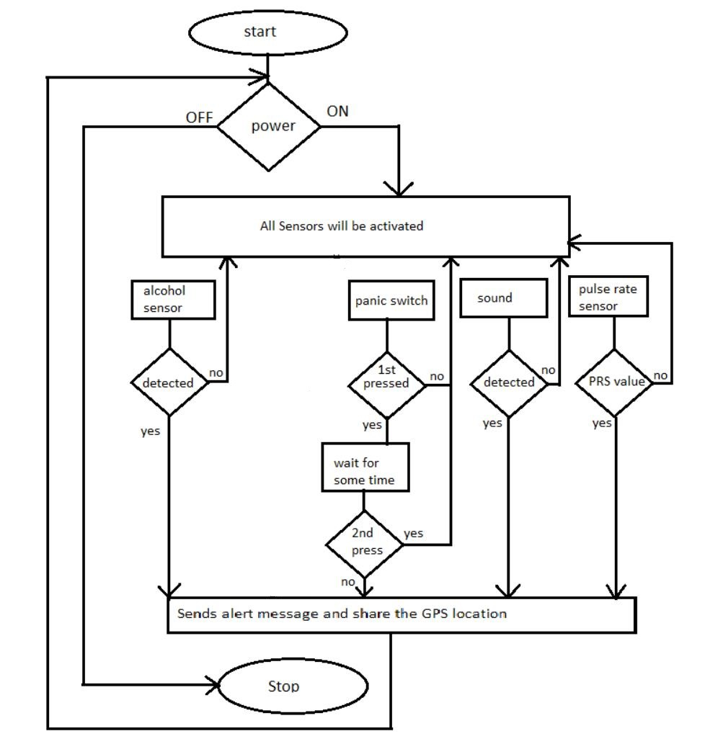
WORKING OF PROPOSED
SYSTEM

Slide 11
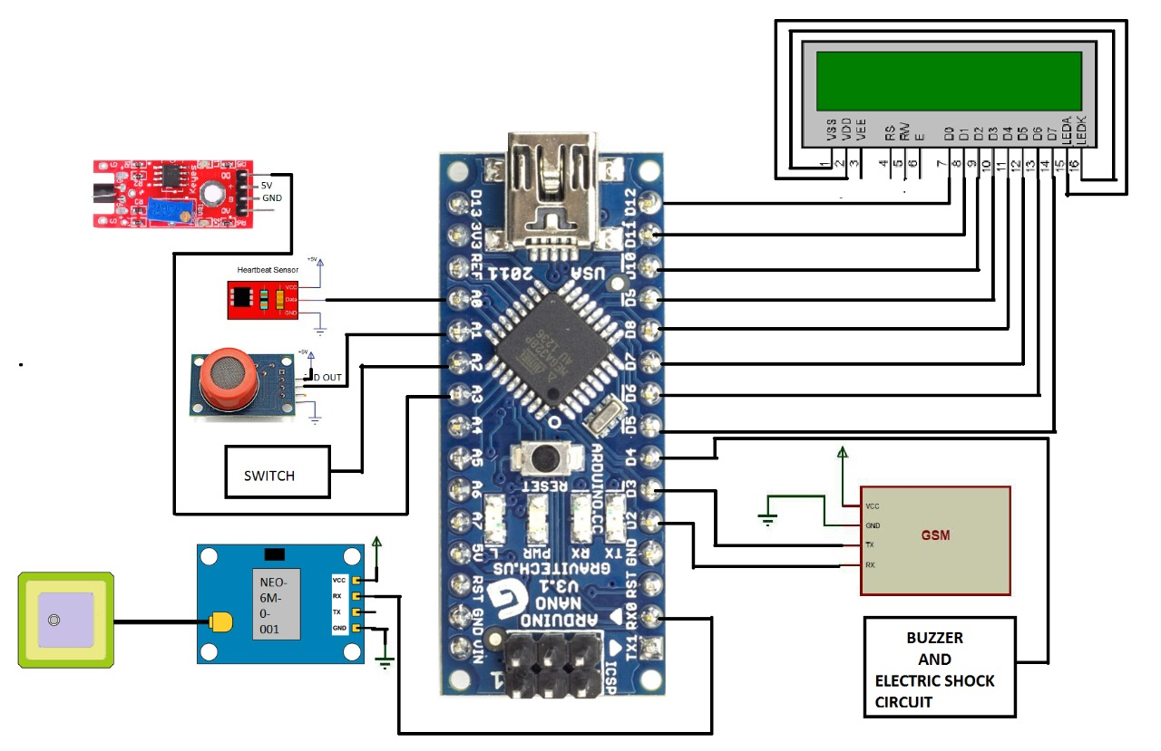
CIRCUIT DIAGRAM
SOUND
LCD
PLUSE
ALCHOL
GPS

Slide 12
HARDWARECOMPONENTS
ARDUINO (Nano)
Alcohol sensor
Sound sensor
Pulse sensor
Global system for mobile (GSM)
Global positioning system (GPS)
Panic Switch
Buzzer
Shock device
Liquid crystal display(LCD)
12

Slide 13
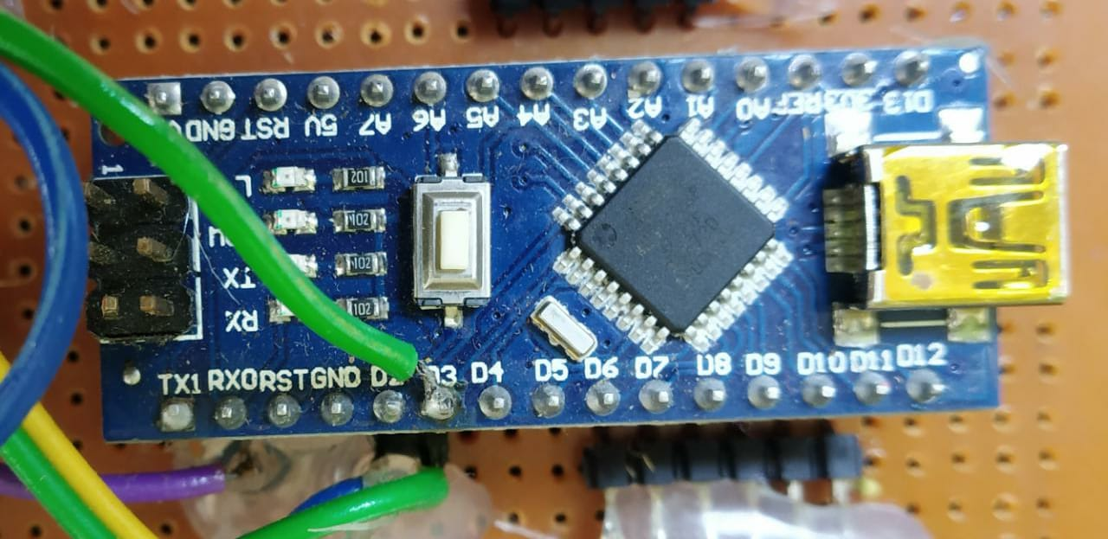
AURDINO(Nano)
Working:-
Arduino Nano is a surface mounted breadboard embedded version with integrated USB
It is a small size controller related to ATmega328

Slide 14
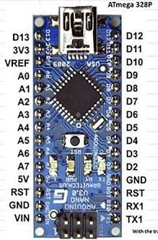
PIN DIAGRAM OF ATmega328
It consists of 30 pins
14-digital I/O pins
8-analog pins
2 reset pins and remaining pins are supply and ground pins

Slide 15
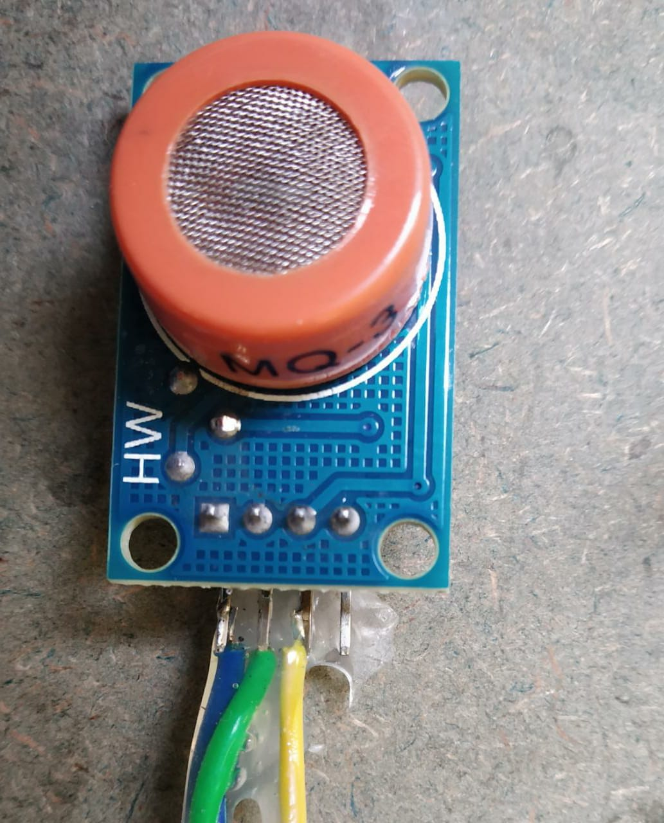
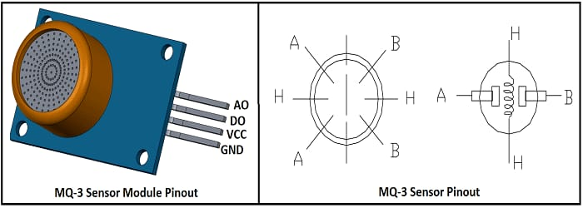
ALCOHOL SENSOR
Principle:-
It detects the alcohol in the presence of air

Slide 16
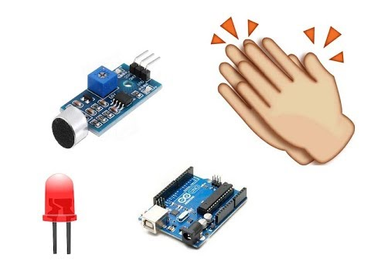
SOUND SENSOR
Principle:-
It works on the principle of micro phone
It converts sound signal to electrical signal

Slide 17
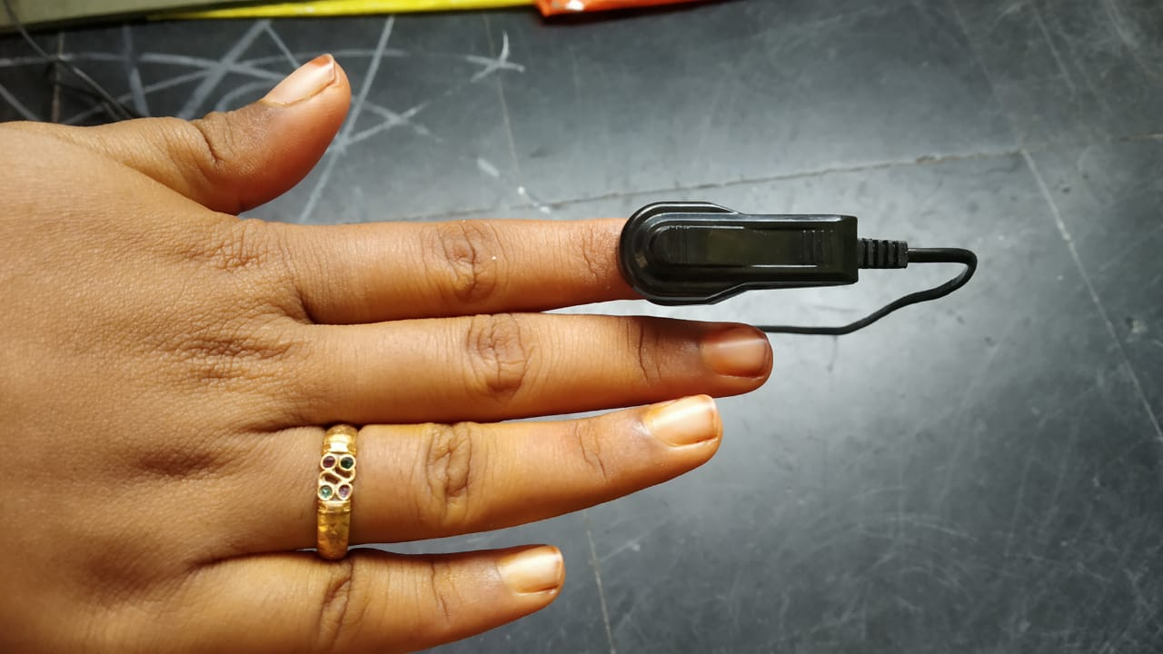
PULSE SENSOR
Principle:-
It works on the principle of light modulation by blood flow through each pulse

Slide 18
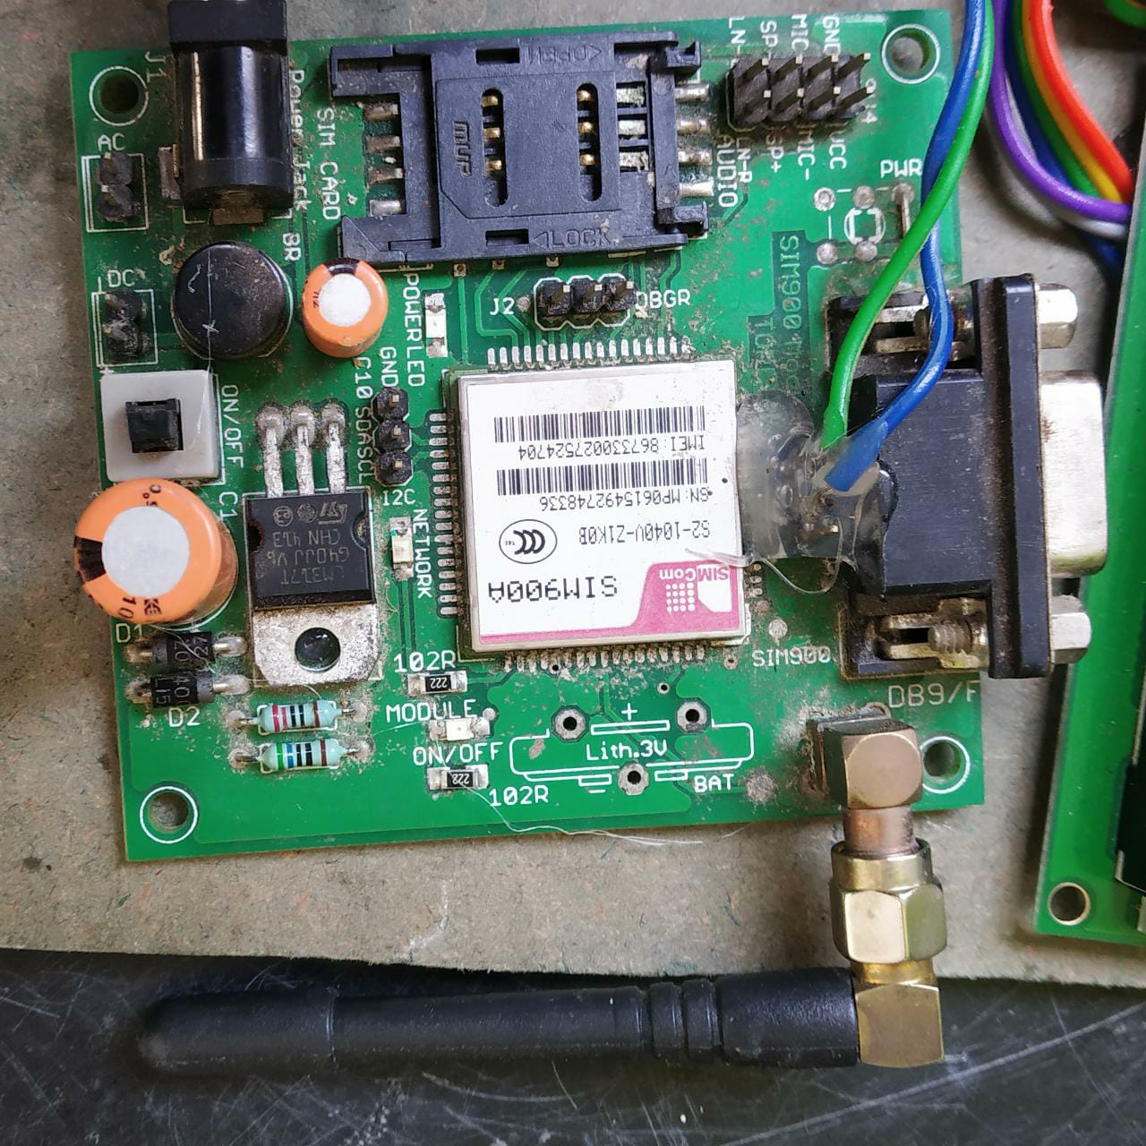
GLOBAL SYSTEM FOR MOBILE (GSM)
Working:-
Global system for mobile is an open source and digital cellular technology used for transmitting mobile data services and operates at the 850MHZ frequency

Slide 19
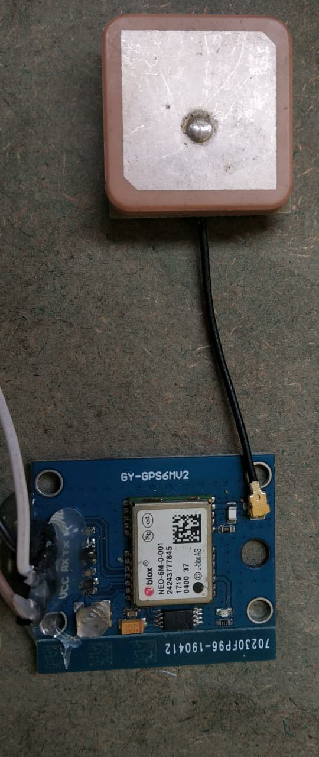
GLOBAL POSITIONING SYSTEM(GPS)
Working:-
The global positioning system is to
provide a world wide navigation
The position is determined from the distance measurements to satellite

Slide 20
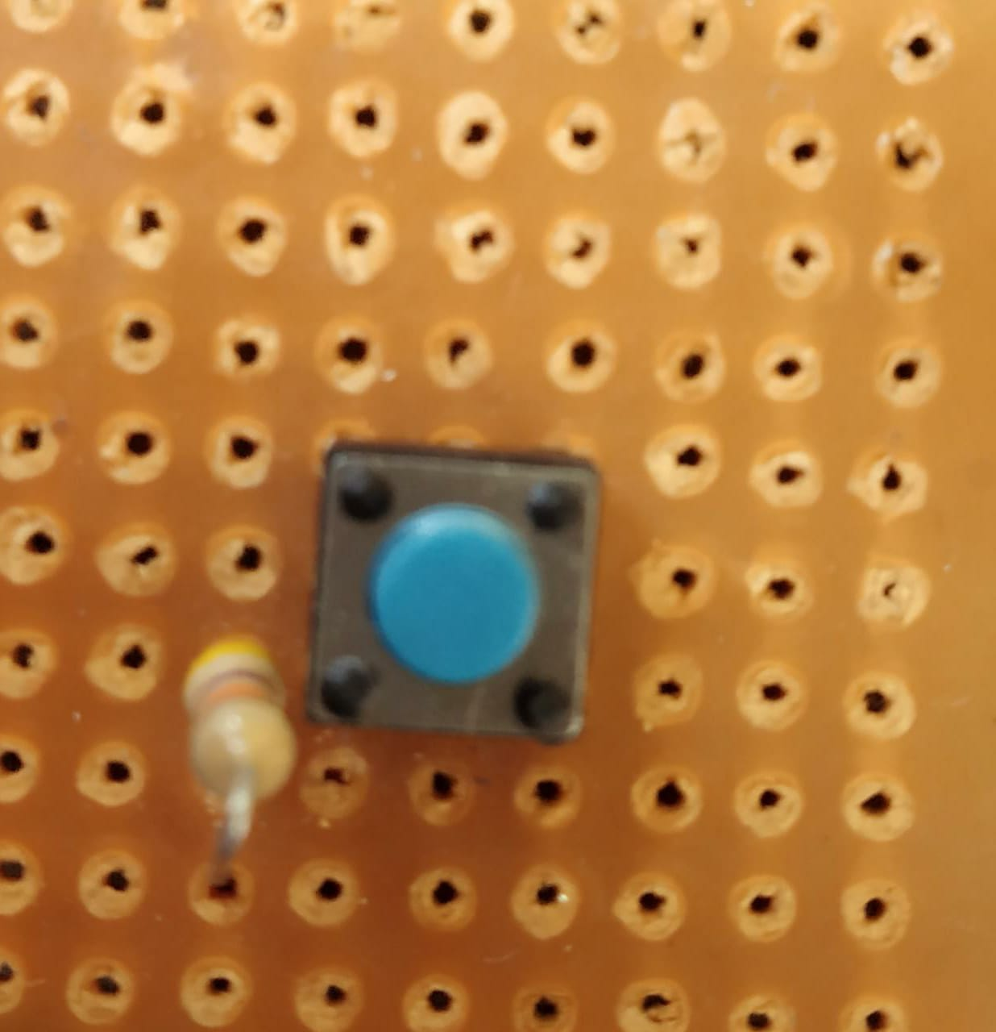
PANIC SWITCH
Working:-
It alert the system and it provides time delay

Slide 21
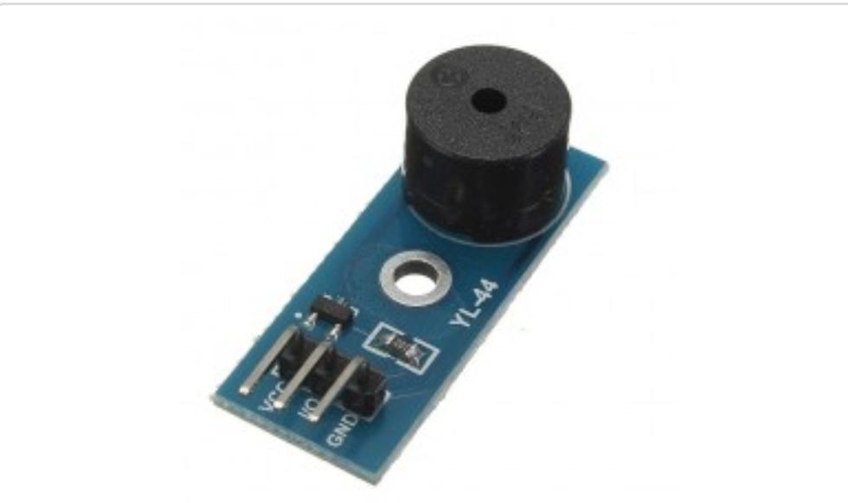
BUZZER
Working:-
Buzzer is a output device it produce beap sound

Slide 22
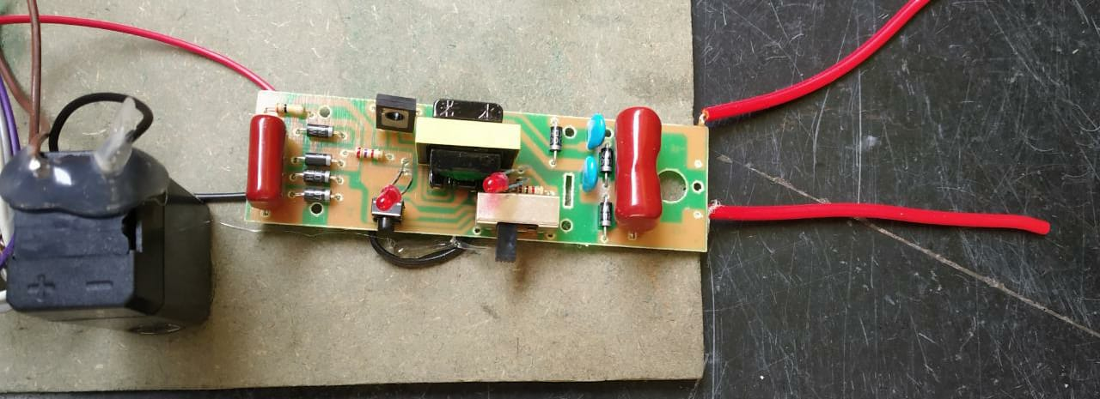
SHOCK DEVICE
Working:-
shock device is a electrical device
It provides electrical shock

Slide 23
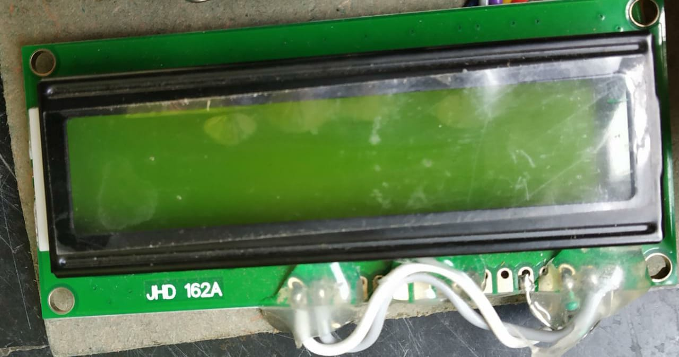
LIQUID CRYSTAL DISPLAY (LCD)
Working:-
LCD is a output device
It is a alpha numeric LCD display module it can display alphabets & numbers

Slide 24
SOFTWARE COMPONENTS
ARDUINO Integrated Development Environment(IDE)
LANGUAGE
Embedded C

Slide 25
ADVANTAGES OF PROPOSED SYSTEM
It is a social cause project
Easy to use
It provides safety at any time and any where
Moderate cost

Slide 26
APPLICATIONS OF PROPOSED SYSTEM
Women security
Children Security
Any Security Applications

Slide 27
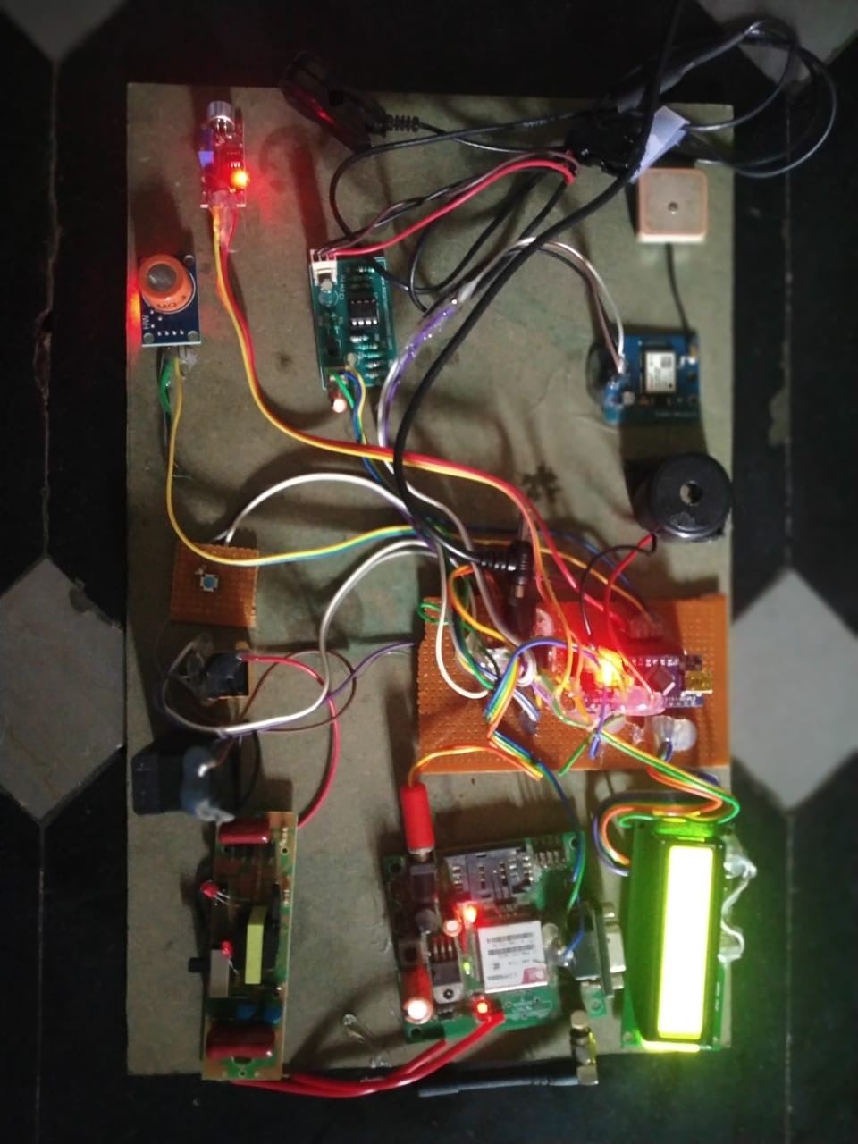
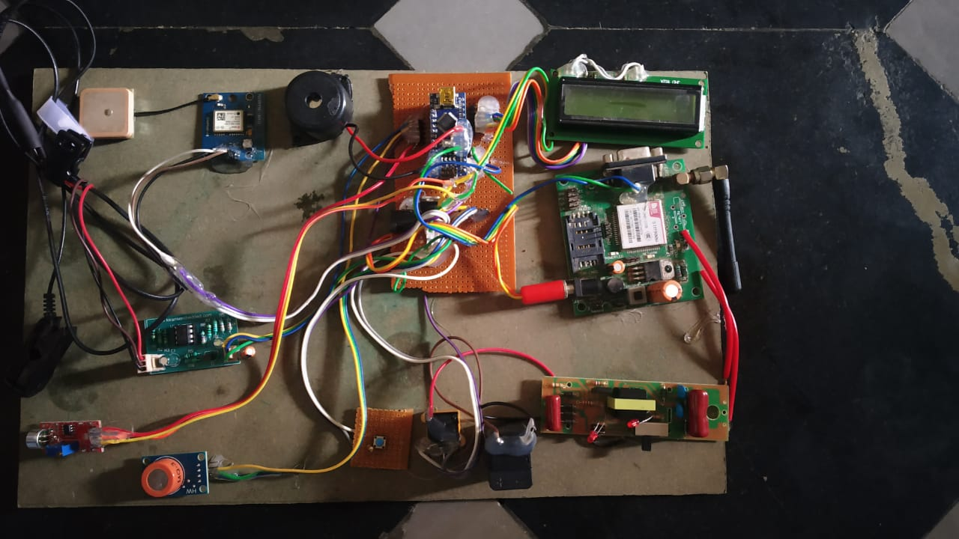
HARDWARE PROTOTYPE
With out power supply
With power supply

Slide 28
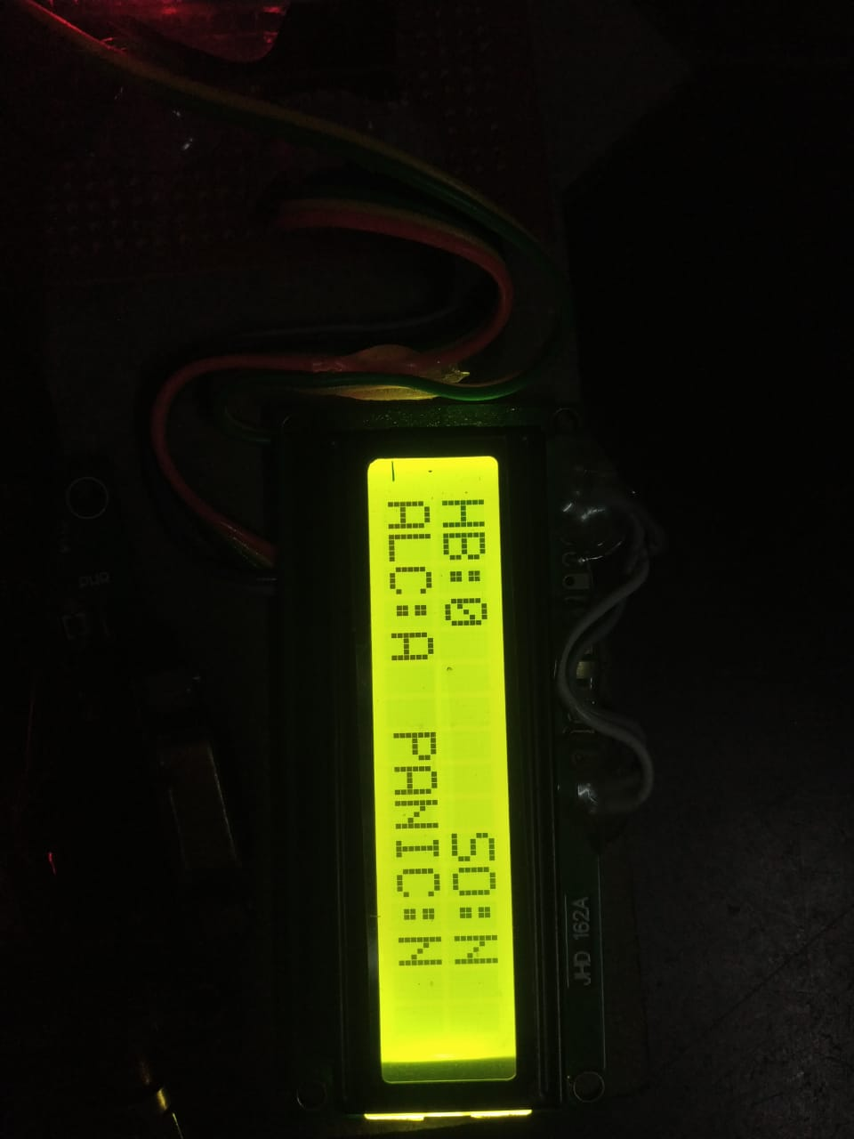
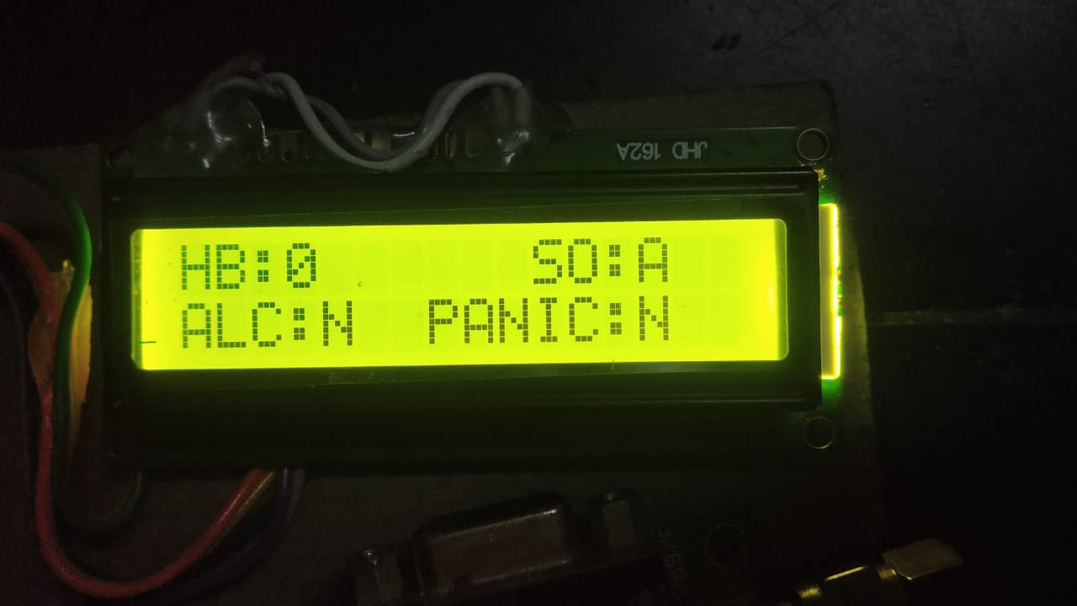
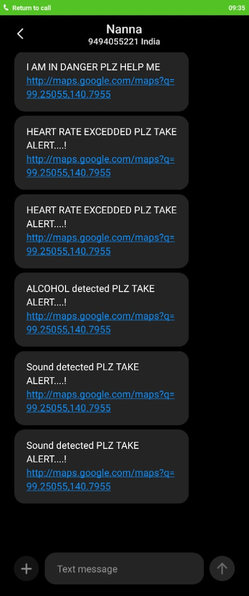
RESULT ANALAYSIS
Fig 1: Indication of Alcohol Sensor
Fig 3: Indication of Sound Sensor
Fig 2: output of Alcohol Sensor
Fig 4: output of Sound sensor

Slide 29
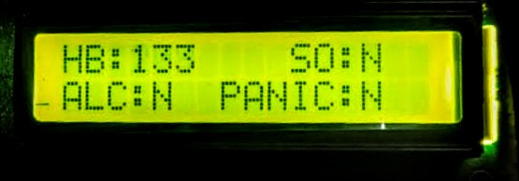
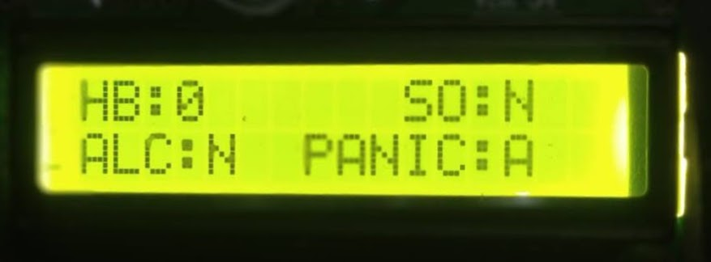
Fig 5: Indication of Heart Beat Sensor
Fig 7: Indication of Panic Switch
Fig 6: output of Heart Beat Sensor
Fig 8: output of Panic Switch

Slide 30
THANKYOU

